Slide 1
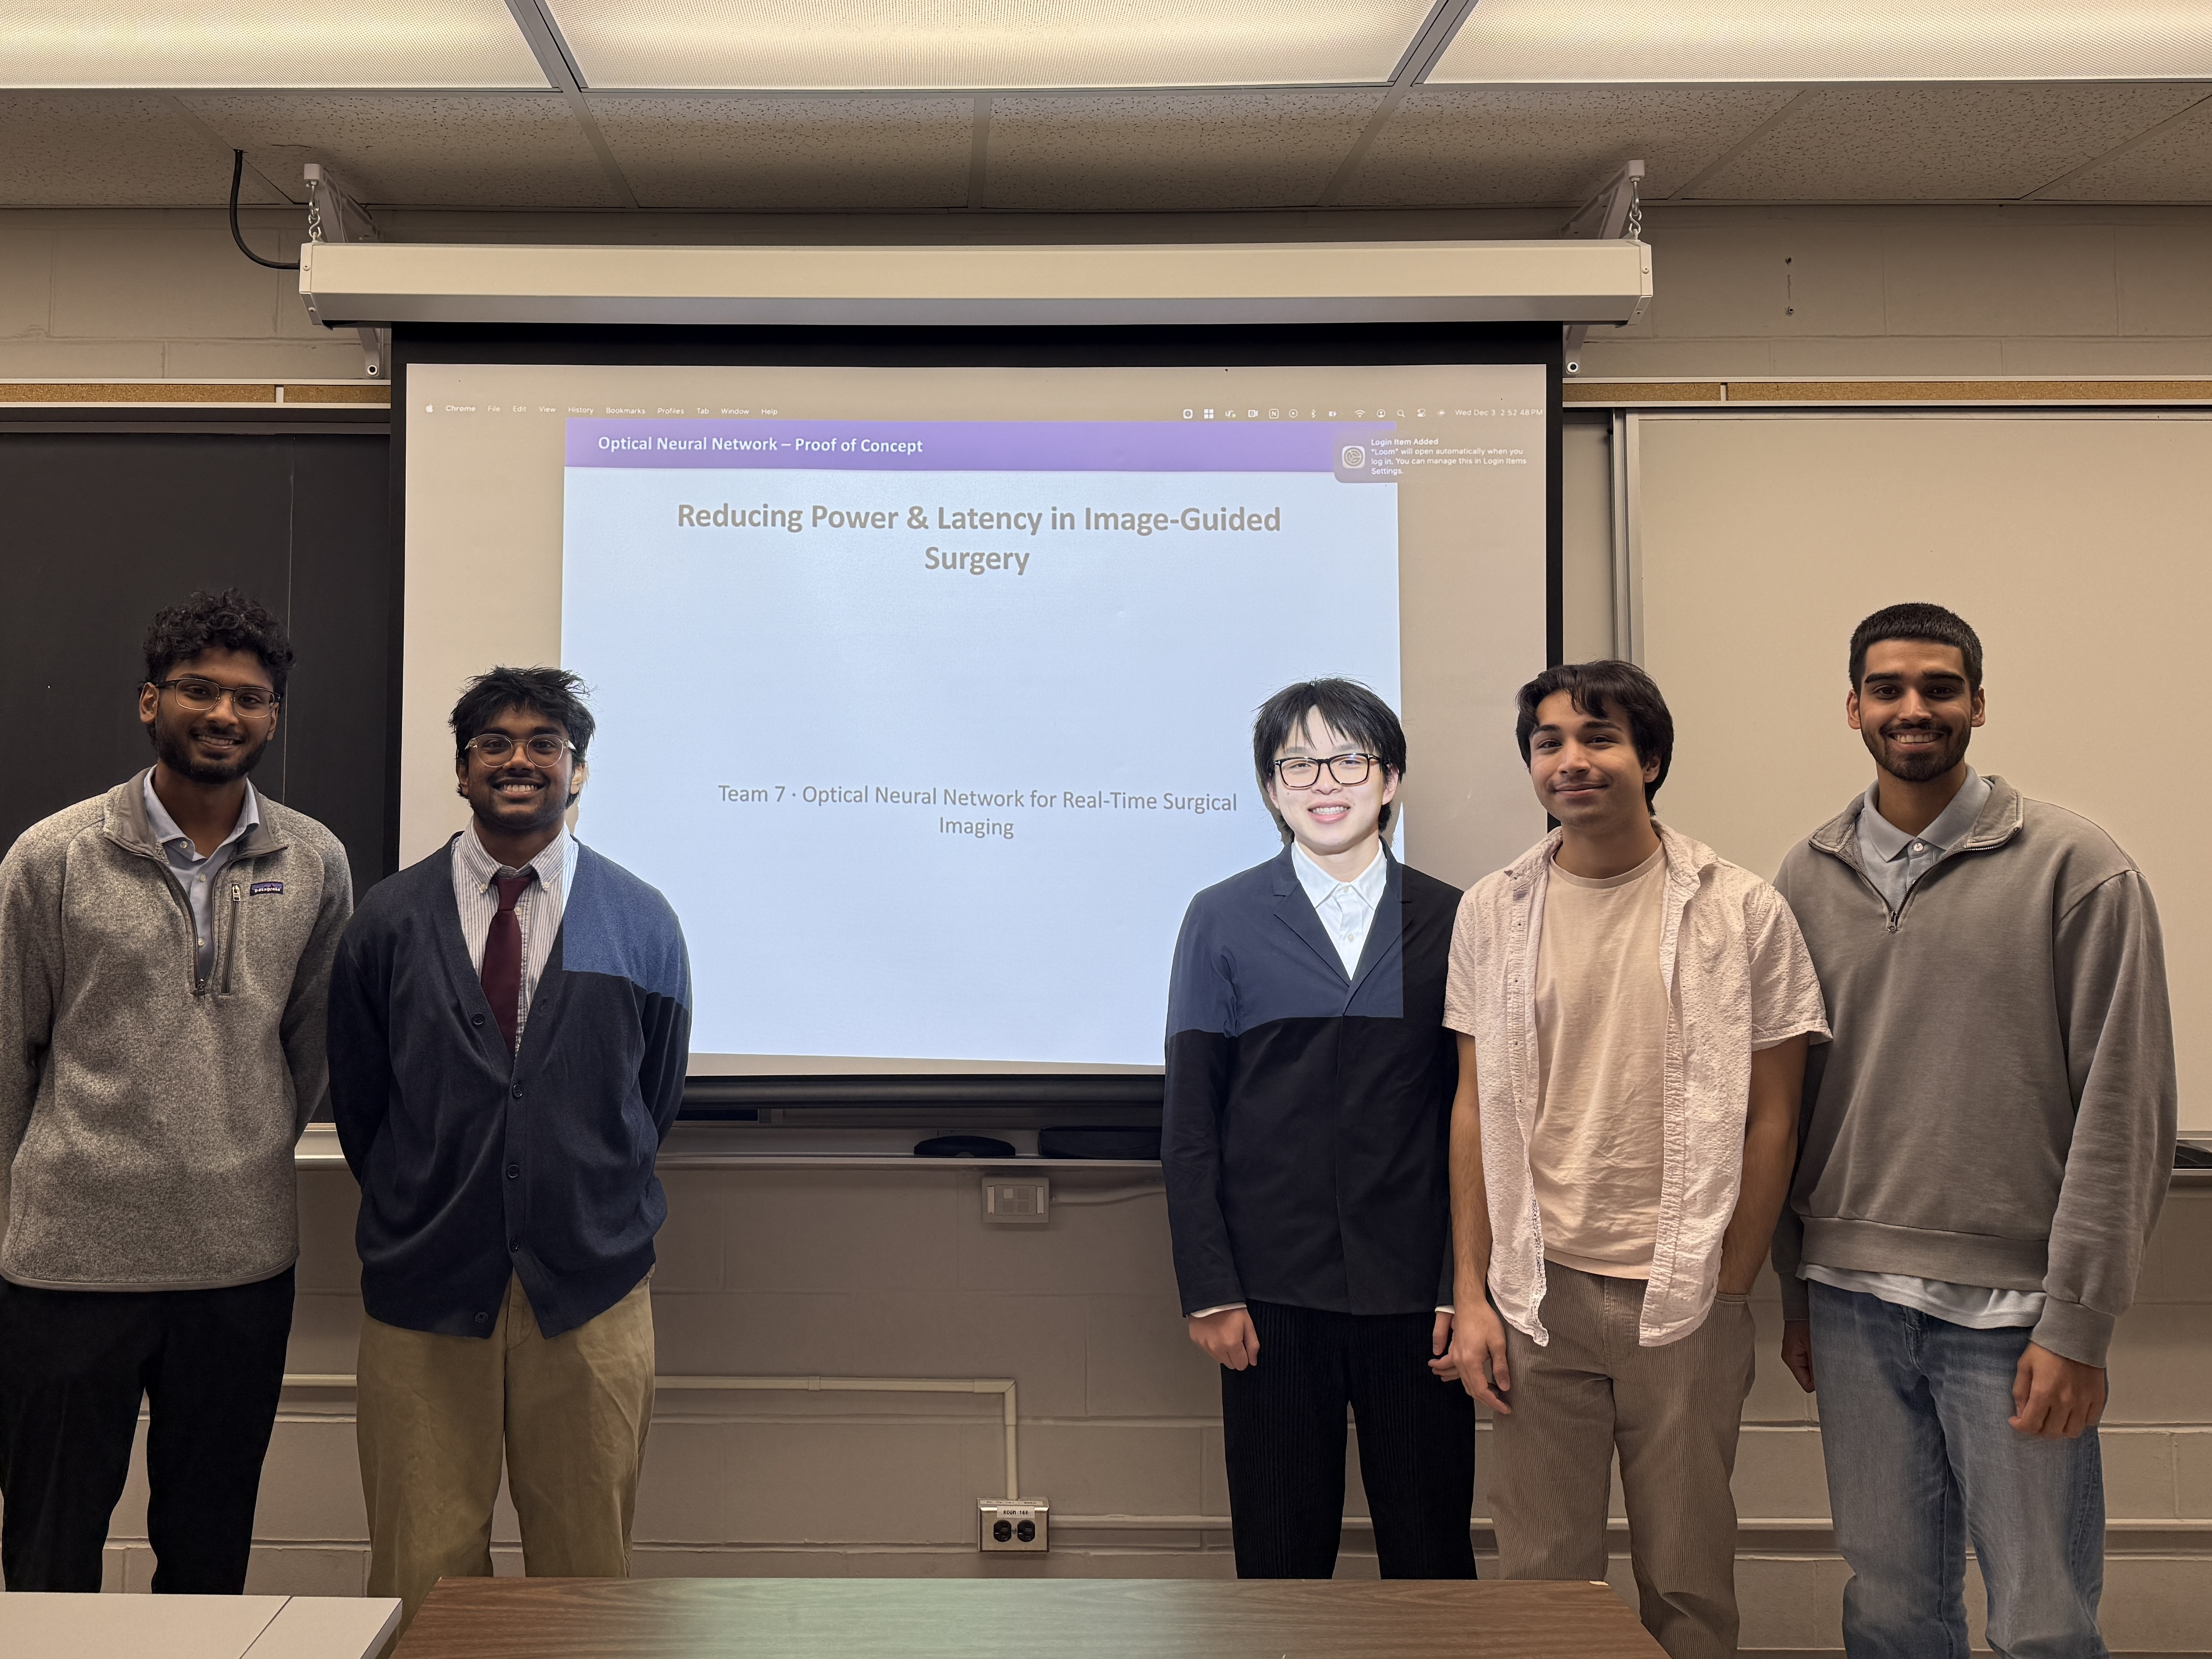
Reducing Power & Latency in Image-Guided Surgery
Optical Neural Network – Proof of Concept
Team 7 · Optical Neural Network for Real-Time Surgical Imaging
Notes:
Introduce the team and the core idea: we are exploring whether a 4f optical convolution stage can offload part of the compute in real-time surgical imaging.
Emphasize the healthcare angle: ORs are thermally and electrically constrained environments, yet clinicians are increasingly asking for AI overlays like segmentation and guidance. Our work looks at how photonics could help keep power, heat, and latency under control.

Slide 2
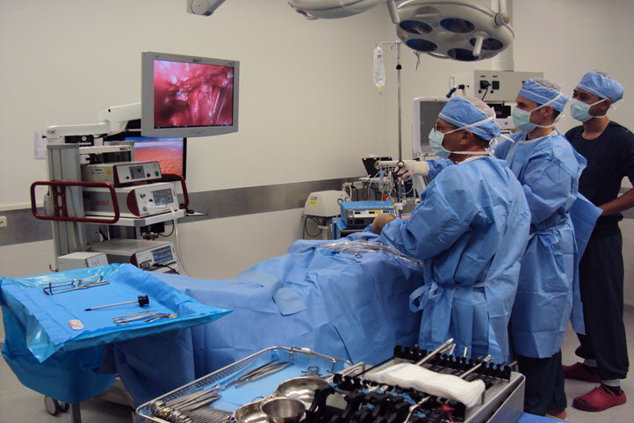
The Problem
Background:
Motivation
13M+ laparoscopic procedures performed globally each year – surgeons operate off a video feed [1].
CNN-based segmentation adds non-trivial compute, power draw, and heat on top of existing imaging stacks.
A study done by USC suggests AI inference can increase OR imaging power usage by up to ~50% [2].
Notes:
Real Time Image Guided Surgery is a surgical procedure that's increasingly common. Surgeons can perform minimally invasive surgeries by operating off a video feed instead of opening up huge holes in the patient. And today, in hospital rooms, AI is used to help surgeons. Convolutional Neural Networks take in each frame of a video feed, apply convolutions on the input with filters and kernels, apply segmentation algorithms, and label specific parts of the frame as anatomical structures. This is in use TODAY, and helps surgeons as they perform minimally invasive surgeries.
But this doesn’t come without cost. CNN-based segmentation can add computational complexity, increased power usage, excess heat output, and other unwanted effects.
A study done by USC suggests that the already considerable power demands placed on an OR could grow by 50% just from adding CNNs. And when latency is on the line, the question is: Can we improve this?

Slide 3

Can We Improve Convolutional Speed?
Background
Convolution complexity scales with image area, filters, and kernel area.
Modern CNNs require millions of parameters; billions of operations [3]
Convolution occupies ~90% of CNN runtime [4]
Goal: use alternative convolution hardware to keep segmentation-level information while lowering power, heat, and latency.
Notes:
One key step of a convolutional neural network is the convolution of the input matrix or tensor with a variety of filtering and masking kernels. This is a computationally intensive step. A study done by UCLA found that for CNNs, convolution took up 90% of runtime.
If we can improve on this step, we can make massive gains in computation, thermal energy, latency, and power.

Slide 4

Design Question
Design Problem Definition
Can we maintain surgical level information while reducing power, heat, and latency, when compared to traditional CNNs?
Notes:
We've talked about the background—and this poses the question:
Can we maintain surgical levelinformation while reducing power,heat, and latency, when compared totraditional CNNs?

Slide 5
Need Statement
Design Problem Definition
Hospitals require methods to perform real-time surgical segmentation with lower power, lower heat, and comparable accuracy to existing GPU-based traditional CNNs.
Notes:
We can format this quite nicely into a need statement:
Hospitals require methods to perform real-time surgicalsegmentation with lower power, lower heat, and comparable accuracy to existing GPU-based traditional CNNs.

Slide 6
Constraints
Design Problem
Functional: alternative convolution must preserve edges, boundaries, and fine anatomical detail.
Non-functional: solution should align with key parameters: less than 300 W [5], <40 GFLOPs per inference [6].
Constraints: Limited budget, must be robust to potential impairments
Assumptions: alternative hardware to conventional silicon will have impairments.
Notes:
To evaluate this properly, we framed our problem with explicit constraints and assumptions:
Functional requirement: The optical convolution must preserve the spatial structures that segmentation models depend on — boundaries, edges, fine detail, and tissue consistency.
Non-functional requirements: The approach should in principle offer comparable outputs in latency, energy usage, and heat dissipation relative to a fully digital pipeline--> this is keeping in mind that we are way more limited in solution design as a student capstone group
Technical constraints: • No access to lasers or SLMs this term • Limited budget for optical hardware • Only amplitude-based modulation feasible in simulation • Must model realistic distortions (blur, pixel bleed, noise) to avoid misleadingly “perfect” results • Must use representative surgical imagery
Assumption: If segmentation remains robust under optical distortions in simulation, then constructing the physical 4f system becomes worthwhile in Winter.

Slide 7
Building Optical Convolution
Background
A thin convex lens acts as a Fourier Transform
Transforms diffraction pattern into spatial positions
Parallel rays (i.e. a flat image) are focused to a DC position
Spatial frequency components of an image cause light to diffract and enter the lens at an angle
This encodes frequency information into spatial information at the Fourier Plane
Parallel Rays
Diffraction Pattern
High Frequency Components
DC
Fourier Plane
Mask
Fourier Plane
Notes:
Use this slide to demystify the optics: two lenses and a mask implement convolution in the spatial domain.
For a non-technical clinical audience member, emphasize that this is simply an alternative 'front-end' for filtering the image before it hits the computer.
Acknowledge that while classification has been demonstrated, segmentation raises the bar because it demands stable boundaries, small structures, and consistent shapes.

Slide 8
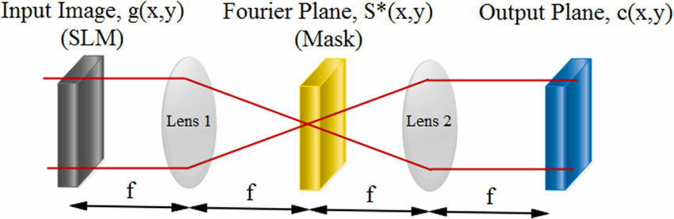
How a 4f Optical System Works
Background
Fourier Transform
Encodes convolution kernel
Inverse Fourier Transform
Classification validated in prior undergrad capstone projects – segmentation is the next challenge
Notes:
Use this slide to demystify the optics: two lenses and a mask implement convolution in the spatial domain.
For a non-technical clinical audience member, emphasize that this is simply an alternative 'front-end' for filtering the image before it hits the computer.
Acknowledge that while classification has been demonstrated, segmentation raises the bar because it demands stable boundaries, small structures, and consistent shapes.

Slide 9
Optical Hardware Setup
Proposed Solution
Collimator
Lens1
Fourier Plane
Lens2
To Digital
Laser
DMD
DMD
Camera
Z= 1f
Z= 2f
Z= 3f
Z= 4f
Input Wavefront
Image Encoding
Fourier Transform
Convolution Mask
Inverse Fourier Transform
Notes:
Introduce the key idea: optical systems can realize convolution physically. Emphasize that this is not speculative – it's grounded in a long history of 4f correlators.
From a healthcare operations perspective, the promise is to execute an expensive part of the CNN without additional electronic power draw, then hand off to lighter-weight digital stages.
Make clear that our goal is a hybrid optical–digital system, not an 'all photonic' OR tower.

Slide 10

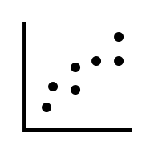


Hybrid Optical–Digital Pipeline
Proposed Solution
Step 01
Step 02
Step 03
Step 04
Laparoscopic Image
Optical Convolution
Segmentation Model
Overlay Mask
Notes:
Show the big-picture pipeline that could plausibly sit inside an OR imaging tower.
Anchor this in existing workflows: the camera and display stay the same. We are inserting an optical stage and a relatively modest digital head.
Reiterate that this term's work validates Stages 1–2 in simulation using classification as our measurable output.

Slide 11
Training a Model to Segment Images
Proposed Solution
Cannot train our model on the convolution outputs of the hardware
Train a digital model using a fast digital approximation of the hardware with the appropriate constraints
Notes:
Now we know the structure of our model, but now we have the challenge of training a model to segment images
Due to time constraints, we cannot train our model on the convolution outputs of the hardware
This requires us to train a digital model using a fast digital approximation of the hardware with the appropriate constraints

Slide 12
Training a Model to Segment Images
Proposed Solution
Calibrate digital model by freezing learned kernels
Retraining it on a smaller sample of convolved images from optical hardware
Essentially transferring the model to work with the optical hardware input feature space
Notes:
Then we calibrate this digital model by freezing the learned kernels and retraining it on a smaller sample of convolved images from the optical hardware, effectively transferrin the model to work with the optical hardware input features space

Slide 13
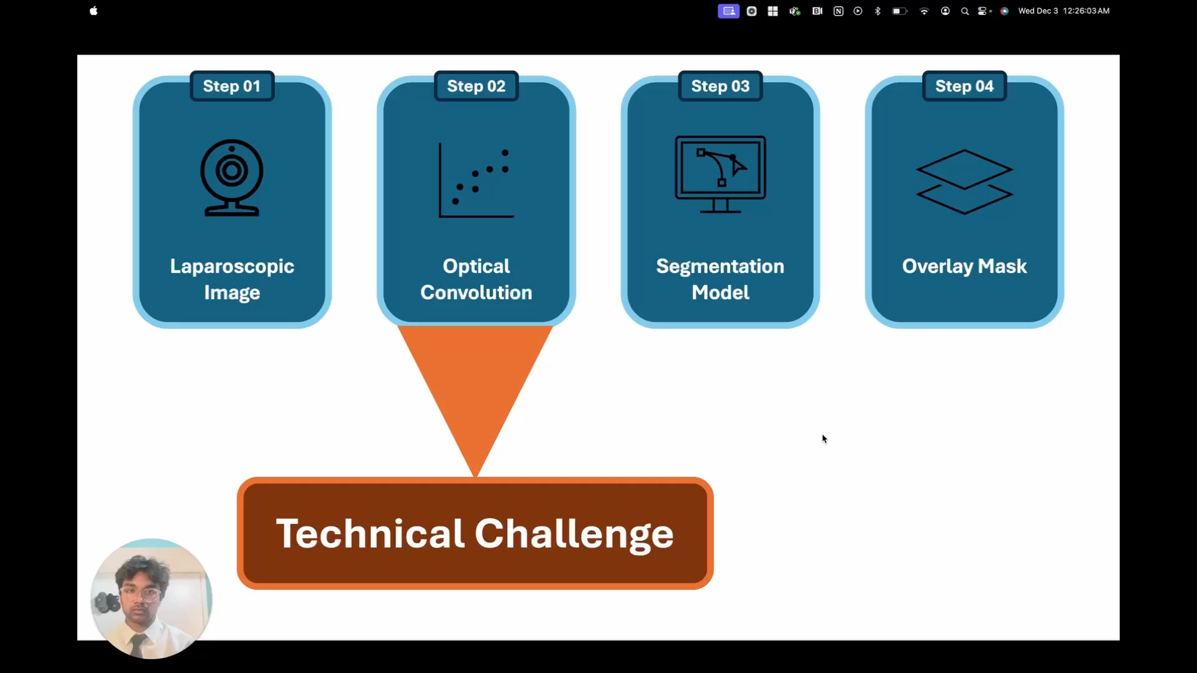
PoC Video
Video Demonstration
LINK
Link

Slide 14
Feasibility & Key Risks
Feasibility Risk Analysis
Risk
Sensitive to vibration, requires precise alignment
Lower-cost hardware limit resolution/detail
Overfitting risk with narrow dataset
Mitigation
Utilizing optical table in Dr. Xu’s lab
Current prototype able to classify organs with 224x224 resolution
Utilize large datasets and try and combine multiple datasets
Classification results suggest remaining risk is mainly architectural, not optical feasibility
Notes:
Address the questions that clinicians and engineers will naturally have: does this really translate to hardware, how hard is it to align, and do you have enough data?
As a consultant, frame this as a risk register: we've identified major risks, have mitigation strategies, and have deliberately chosen a PoC that attacks the riskiest assumption first – optical preservation of structure.

Slide 15
Next Steps – Winter Term & Beyond
Next Steps
Acquire Hardware
Develop segmentation model
& additional software
Lenses
Laser
DMDs
CMOS Camera
Training pipeline scripts
Image impairment scripts
Segmentation Model
GUI
Video feed integration
Build a 4f system
Engage clinicians and stakeholder throughout
Verify alignment
Evaluate against optics simulation
Collect optically convolved frames
New dataset of feature maps
Integrate software head and evaluate
Notes:
Lay out a clear, pragmatic roadmap that a clinical or engineering stakeholder can understand.
Highlight that the next phase is hardware and power/latency measurement, followed by adding a segmentation head and starting early conversations with surgeons about workflow fit.
This positions the project as de-risked and thoughtfully staged rather than speculative.

Slide 16
References
References
[1] iData Research, “Over 13 Million Laparoscopic Procedures Are Performed Globally Every Year,” iData Research, 2023. [Online]. Available: https://idataresearch.com/over-13-million-laparoscopic-procedures-are-performed-globally-every-year/. [Accessed: Dec. 3, 2025].
[2] USC Viterbi School of Engineering, “How Can Computing for AI and Other Demands Be More Energy Efficient?” Apr. 28, 2025. [Online]. Available: https://viterbischool.usc.edu/news/2025/04/how-can-computing-for-ai-and-other-demands-be-more-energy-efficient/. [Accessed: Dec. 3, 2025].
[3] P. Maji and R. Mullins, “On the Reduction of Computational Complexity of Deep Convolutional Neural Networks,” Entropy, vol. 20, no. 4, p. 305, 2018, doi: 10.3390/e20040305.
[4] V. Sze, Y.-H. Chen, T.-J. Yang, and J. Emer, “Efficient Processing of Deep Neural Networks: A Tutorial and Survey,” in *Proceedings of the International Conference on Artificial Neural Networks (ICANN)*, 2014. [Online]. Available: https://vast.cs.ucla.edu/sites/default/files/publications/CNN_ICANN14.pdf. [Accessed: Dec. 3, 2025].
[5] S. Prajwal, P. P. Kumari, H. M. V, and A. U. Rani, “A Study on Energy Consumption in AI-Driven Medical Image Segmentation,” J. Imaging, vol. 11, no. 2, p. 60, Feb. 2025, doi: 10.3390/jimaging11020060.
[6] A. Benedetti, D. D. Bloise, and E. Iadanza, “Benchmarking U-Net and V-Net for medical image segmentation on GPUs,” Journal of Imaging, vol. 6, no. 12, p. 138, Dec. 2020, doi: 10.3390/jimaging6120138
Notes:
This positions the project as de-risked and thoughtfully staged rather than speculative.

Slide 17
Questions & Discussion
Discussion
Notes:
Invite questions on three axes: clinical value, technical feasibility, and integration into existing OR stacks.
Be prepared to talk about regulatory and integration considerations at a high level, making clear that this is early-stage research but aligned with real-world constraints.

